Slide 1
Presenter Responsibilities
Verify that the data you’re going to use does not contain any personally identifiable information (PII), and is set up with the correct examples and scenarios
If the focus of your session changes during your preparation, update Title and Description of session as necessary, following steps outlined in your presenter acceptance email from KF Events
Practice your session and ensure content is no less than 45 minutes, no greater than 60 minutes
If you are presenting a recorded session, prior to uploading files to KF portal, review your full recording to verify that:
Audio is of good quality
Software screens are clear and fields mentioned are easy to view
Production data is not included/No PII is visible
Information provided is accurate (a co-worker may be able to review and assist with this)

Slide 2
Using this PowerPoint – remove this slide
If you need more slides, duplicate one from the template and modify it, don’t create a new one.
Read the notes for the slides. The notes offer information about the slide and suggestions on how to use the slide. The notes are located in the section below the slide.
The built-in bullets and the heading alignment are part of the template. Do not change them.
Notes:
Notes—
Remove this slide from your presentation before publishing your PPT.

Slide 3
Tips for Presenting– remove this slide
Notes:
Prepare
Make a plan. Find a lesson plan template you can use, think about the process of chunking your presentation into small bits of information. When you break up a presentation into small parts, it's easier for you to deliver.
Think about when you first learned the topic or when you’ve helped someone else with the topic, and use that knowledge to anticipate what the attendees might find helpful. Knowing what questions might be asked helps you manage fears of the unknown.
Make sure the data you’re going to use is set up with the right examples and scenarios.
Practice
Practice with someone who knows your topic. Practice with someone who doesn’t know your topic. Make adjustments based on feedback.
Does it flow logically?
Are there any gaps?
Can you, and have you, made connections (if they exist) between each part of your presentation?
How’s your timing – is the presentation too long, or too short?
Present
Become familiar with your physical and virtual presentation room before you record or present your session. Knowing the environment helps settle nerves.
Verify that you have the necessary programs to conduct your session (such as Zoom, Word, Excel, PowerPoint, Internet Explorer, or an equivalent browser).
To the greatest extent possible, your physical presentation room should be free from ambient noise and distractions including other people, pets, mobile phones, etc. Think of your session as a radio broadcast—any distractions diminish the experience.
Give yourself enough time to become familiar with the tools you will use. If possible, work with someone on your team who understands the software you’ll use for your virtual meeting room.
Pay close attention to your audio quality; do a few test recordings to see how you sound.
If you are presenting a live session, have your materials (PPT, documents, reports) on a flash drive for backup.
Never eat food or chew gum during your online session. If you need to drink water during your session, do so quietly.
Dress professionally; choose something that you would wear to present onsite at WASWUG. Plain-colored shirts without patterns/stripes tend to display well on remote sites.
Special considerations for presenting to a live audience:
Have a colleague in your presentation room or on the recoding platform for technical support and moderation. If they know your topic, that’s a bonus and you can call on them as a resource (but only if you really need to, remember it’s your presentation).
When possible, engage learners by asking them to open their phone lines and share their thoughts and experiences about the topic. Use open-ended questions to get their feedback.
If someone asks a question you don’t know the answer to, that’s okay, but be willing to perhaps work with them to find the solution (after the session).
Bonus
Smile and enjoy yourself – even if your audience cannot see you, it will come through in your presentation!

Slide 4
Instructions for Reference Materials – remove this slide
If you have a handout in addition to your PowerPoint presentation,
use the template provided on the WASWUG website
https://waswug.wsipc.org/present/presenters-fall-2021#
To easily associate your handout with your session use the naming convention: Handout - <insert name of your session>
Notes:
Notes— Remove this slide from your presentation before publishing your PPT.
Attendees may appreciate having materials they can refer to during your session.
Use the handouts template if you have additional information to provide that’s not in your PPT.

Slide 5
Title Slide
Presenter 1:
Presenter 2:

Slide 6
Reference Materials – WSIPC Guide(s)
You can find the Guide(s) you need for this session on SkyDoc, under WSIPC Educational Materials.
WSIPC Guide to <insert name of guide>
If you do not have access to the WSIPC Educational Materials area of SkyDoc, contact info@wsipc.org to request an electronic version of the Guide.
Notes:
Use this slide to provide the name of the WSIPC Guide you are using in this session.
Remove this slide if you are not referencing any WSIPC Guides during your session.

Slide 7
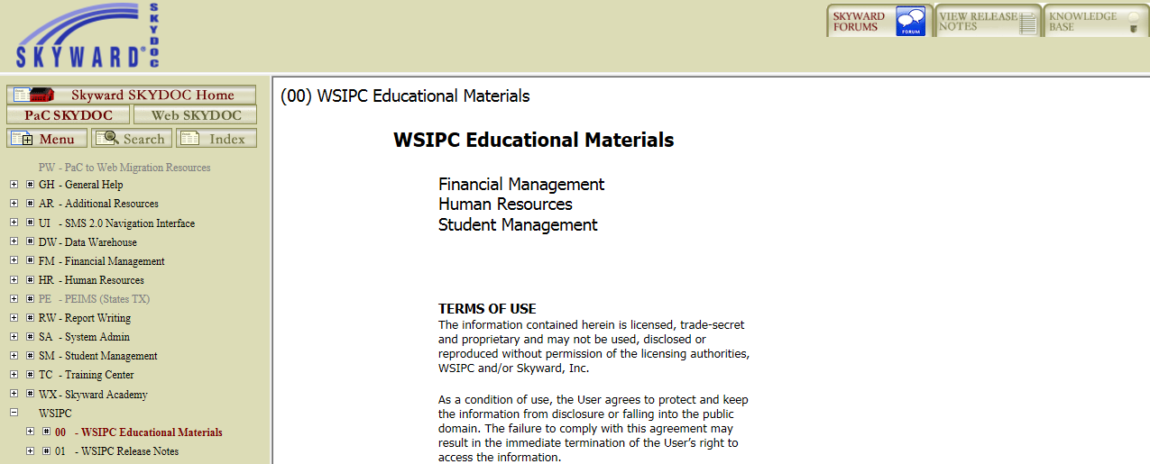
Locate the Guide on SkyDoc
Notes:
Remove this slide if you are not referencing any WSIPC Guides during your session.

Slide 8
Reference Materials - Qmlativ
Resources for this session can be found within the Qmlativ Knowledge Hub
Click Knowledge Hub near the top right of the screen
Select Help Center to access related documentation
Select Professional Development Center to access self-paced courses related to your job function
Notes:
Use this slide to provide information about accessing Help Center & PDC.
Remove this slide if you are not presenting a Qmlativ session.

Slide 9
Reference Materials - Handout
During my session I’ll be referring to information you can find in a handout I’ve posted to the OnAIR virtual platform:
Handout -<insert the name of your session>
Notes:
Use this slide to provide the name of the handout you are using in this session.
Remove this slide if you are not referencing any handouts during your session.

Slide 10
In this session, <select from below>
<choose: “you’ll see…” or ”I’ll show you…” or “I’ll demonstrate…”>
Objective #1
Objective #2
Objective #3
Objective #4
Etc.
Notes:
Objective Slide—
Replace the bullets with your objectives.
Objectives are similar to an agenda but written slightly different.
Suggested Dialog for this slide—
“In this session you’ll see:”
or
“In this session I’ll show you/demonstrate:
How to …
When to …
Whether…
A scenario of…
An example of…]”

Slide 11
Demonstration
Let’s take a look…
Notes:
Demonstration Slide—
This slide let’s you and the attendees know that you’re now transitioning into the software to demonstrate the topic. If you’re presentation is on conceptual information only, and you won’t be logging into the software, then remove this slide.

Slide 12
Join the Qmlativ Skyward Community!
The WSIPC Cooperative Group (in the Skyward Community) is a group designed just for Cooperative members. It’s a space where you can collaborate and share knowledge as you become more familiar with Qmlativ.
To access the WSIPC Cooperative Group:
In Qmlativ, click Knowledge Hub near the top right of the screen
Click Community
Click Groups at the top of the screen
Click WSIPC Cooperative, WA
Notes:
If you are not presenting a Qmlativ session, remove this slide from the deck.

Slide 13
Questions?
Thank you!
Notes:
Suggested dialog for presenting—
“If you have any final questions, I can address those now. Otherwise, thank you for attending and enjoy the rest of WASWUG.”

Slide 14
Title and Content Slide
Level 1
Level 2
Level 3
Level 4
Level 5
Level 6
Notes:
Extra slide—
Use or delete

Slide 15
Two Content Slide
Notes:
Extra slide—
Use or delete

Slide 16
Content with Caption Slide
Notes:
Extra slide—
Use or delete

Slide 17
Title Only Slide
Notes:
Extra slide—
Use or delete

Slide 18
Notes:
Extra slide—
Use or delete

