Slide 1
Presenter Responsibilities – remove this slide
Verify that the data you’re going to use does not contain any personally identifiable information (PII), and is set up with the correct examples and scenarios.
If the focus of your session changes during your preparation, update Title and Description of session as necessary, following steps outlined in your presenter acceptance email.
Practice your session and ensure content is no less than 45 minutes, no greater than 60 minutes (unless you are providing a 90-minute presentation or one that spans more than a single time block).

Slide 2
Using this PowerPoint – remove this slide
If you need more slides, duplicate one from the template and modify it, don’t create a new one.
Read the Notes section for each slide. The notes offer information about the slide and suggestions on how to use the slide. The notes are located in the section below the slide.
The built-in bullets and the heading alignment are part of the template. Do not change them.
Notes:
Notes—
Remove this slide from your presentation before publishing your PPT.

Slide 3
Tips for Presenting– remove this slide
Notes:
PREPARE
Make a plan. Find a lesson plan template you can use. Think about the process of chunking your presentation into small bits of information. When you break up a presentation into small parts, it's easier for you to deliver.
Think about when you first learned the topic or when you’ve helped someone else with the topic, and use that knowledge to anticipate what the attendees might find helpful. Knowing what questions might be asked helps you manage fears of the unknown.
Make sure the data you’re going to use does not contain any personally identifiable information (PII), and is set up with the right examples and scenarios.
PRACTICE
Practice with someone who knows your topic. Practice with someone who doesn’t know your topic. Make adjustments based on feedback.
Does it flow logically?
Are there any gaps?
Can you, and have you, made connections (if they exist) between each part of your presentation?
How’s your timing – is the presentation too long, or too short?
PRESENT
Demonstrate within the application unless the presentation is on conceptual functions, such as how data is being calculated or what is occurring behind the scenes.
Be conversational and engaging. Make eye contact with individuals as you speak. Ask pertinent and relevant questions when possible.
Pause after asking questions or introducing a new concept or terminology to allow the attendee to process the question/concept.
Repeat attendee questions to ensure everyone (including your virtual audience) heard the question before you respond.
Always have your materials (PPT, documents, reports) on a flash drive for backup.
Become familiar with your physical and virtual presentation room before you record or present your session. Knowing the environment helps settle nerves.
Never eat food or chew gum during your session. If you need to drink water during your session, do so quietly.
Dress professionally. Plain-colored shirts without patterns/stripes tend to display well on remote sites.
A colleague will be in your presentation room for technical support and moderation. If they know your topic, that’s a bonus and you can call on them as a resource (but only if you really need to, remember it’s your presentation).
When possible, engage learners by asking them to share their thoughts and experiences about the topic. Use open-ended questions to get their feedback.
If someone asks a question you don’t know the answer to, that’s okay, but be willing to perhaps work with them to find the solution (after the session).
BONUS
Smile and enjoy yourself – even if your audience cannot see you, it will come through in your presentation!

Slide 4
Title Slide

Slide 5
Hello!
I am [First Name] [Last Name]
You can find me at @username
Notes:
This is introduction slide. Be sure to update it with your information. To change the photo, simply right click on the image, select ‘change picture’ and look for a photo of yourself to include.

Slide 6
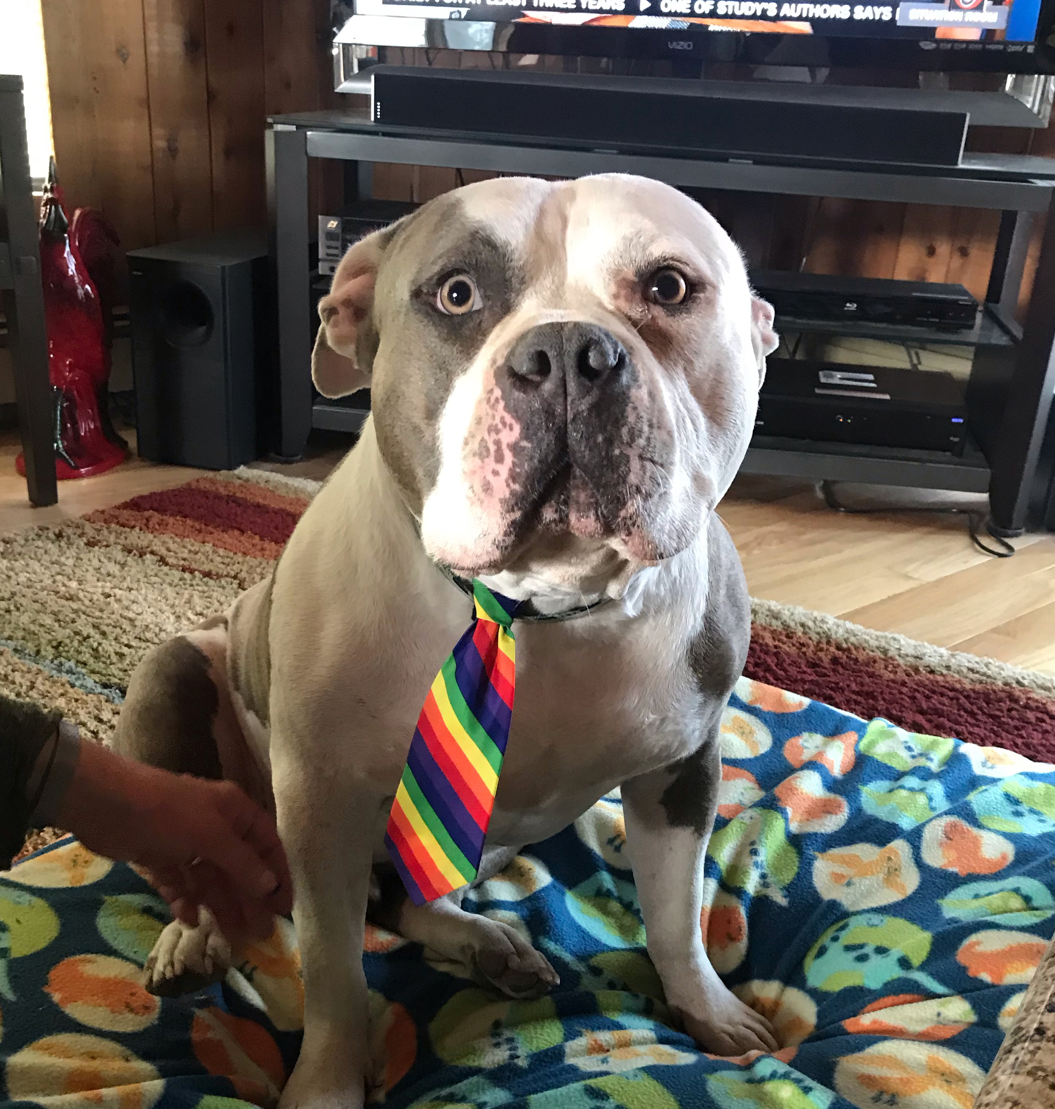
Team Presentation
[First / Last Name] [JOB TITLE]
[Organization]
[First / Last Name] [JOB TITLE]
[Organization]
[First / Last Name] [JOB TITLE]
[Organization]
[First / Last Name] [JOB TITLE]
[Organization]
Notes:
If there is more than one presenter, use this slide to introduce everyone. To change the photos, simply right click on the image, select ‘change picture’ and look for the photo you’d like to include.

Slide 7
Instructions for Reference Materials – remove this slide
If you have a handout in addition to your PowerPoint presentation, use the template provided on the WASWUG website:
https://waswug.wsipc.org/present/presenter-2023
To easily associate your handout with your session use the naming convention: Handout - <insert name of your session>
Notes:
Notes— Remove this slide from your presentation before publishing your PPT.
Attendees may appreciate having materials they can refer to during your session.
Use the handouts template if you have additional information to provide that’s not in your PPT.

Slide 8
Reference Materials – WSIPC Guide(s)
You can find the Guide(s) you need for this session on SkyDoc, under WSIPC Educational Materials
WSIPC Guide to <insert name of guide>
If you do not have access to the WSIPC Educational Materials area of SkyDoc, contact info@wsipc.org to request an electronic version of the Guide
Notes:
Use this slide to provide the name of the WSIPC Guide you are using in this session.
Remove this slide if you are not referencing any WSIPC Guides during your session.

Slide 9
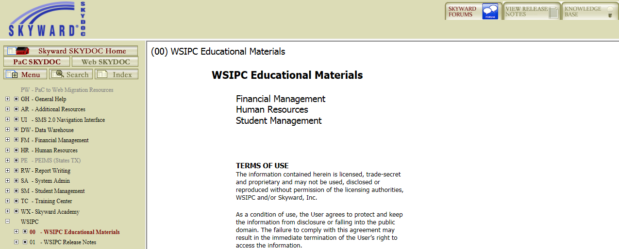
Locate the Guide on SkyDoc
Notes:
Remove this slide if you are not referencing any WSIPC Guides during your session.

Slide 10
Reference Materials - Qmlativ
Resources for this session can be found within the Qmlativ Knowledge Hub
Click Knowledge Hub near the top right of the screen
Select Help Center to access related documentation
Select Professional Development Center to access self-paced courses related to your job function
Notes:
Use this slide to provide information about accessing Help Center & PDC.
Remove this slide if you are not presenting a Qmlativ session.

Slide 11
Reference Materials - Handout
During my session I’ll be referring to information you can find in a handout I’ve posted to the WASWUG event app and the Attendee Hub virtual platform:
Handout -<insert the name of your session>
Notes:
Use this slide to provide the name of the handout you are using in this session.
Remove this slide if you are not referencing any handouts during your session.

Slide 12
In this session, <select from below>
<choose: “you’ll see…” or ”I’ll show you…” or “I’ll demonstrate…”>
Objective #1
Objective #2
Objective #3
Objective #4
Etc.
Notes:
Objective Slide—
Replace the bullets with your objectives.
Objectives are similar to an agenda but written slightly different.
Suggested Dialog for this slide—
“In this session you’ll see:”
or
“In this session I’ll show you/demonstrate:
How to …
When to …
Whether…
A scenario of…
An example of…]”

Slide 13
Demonstration
Let’s take a look…
Notes:
Demonstration Slide—
This slide let’s you and the attendees know that you’re now transitioning into the software to demonstrate the topic. If you’re presentation is on conceptual information only, and you won’t be logging into the software, then remove this slide.

Slide 14
Join the Qmlativ Skyward Community!
The WSIPC Cooperative Group (in the Skyward Community) is a group designed just for Cooperative members. It’s a space where you can collaborate and share knowledge as you become more familiar with Qmlativ.
To access the WSIPC Cooperative Group:
In Qmlativ, click Knowledge Hub near the top right of the screen
Click Community
Click Groups at the top of the screen
Click WSIPC Cooperative, WA
Notes:
If you are not presenting a Qmlativ session, remove this slide from the deck.

Slide 15
Thanks!
Any questions?
You can find me at @username
& user@mail.me
Notes:
This is the exit slide. Be sure to update it with your information. To change the photo, simply right click on the image, select ‘change picture’ and look for a photo of yourself to include.

Slide 17
Title Slide
Notes:
Extra slide

Slide 18
THIS IS A SUBTITLE SLIDE

Slide 19
Hello!
I am [First Name] [Last Name]
You can find me at @username
Notes:
Extra slide, just in case… This is introduction slide. Be sure to update it with your information. To change the photo, simply right click on the image, select ‘change picture’ and look for a photo of yourself to include.

Slide 20
Team Presentation
[First / Last Name] [JOB TITLE]
[Organization]
[First / Last Name] [JOB TITLE]
[Organization]
[First / Last Name] [JOB TITLE]
[Organization]
[First / Last Name] [JOB TITLE]
[Organization]
Notes:
Extra slide, Just in Case… If there is more than one presenter, use this slide to introduce everyone. To change the photos, simply right click on the image, select ‘change picture’ and look for the photo you’d like to include.

Slide 21
Thanks!
Any questions?
You can find me at @username
& user@mail.me
Notes:
Extra Slide, Just in Case… This is the exit slide. Be sure to update it with your information. To change the photo, simply right click on the image, select ‘change picture’ and look for a photo of yourself to include.

Slide 22
1.
Transition headline

Slide 23
Quotations are commonly printed as a means of inspiration and to invoke philosophical thoughts from the reader.

Slide 24
A picture is worth a thousand words
Place an image in the space to the right.

Slide 25
Our process
is easy
first
second
last

Slide 26
Fun message bubble, adjustable icons, and WASWUG logo for use

